Slide 1
The Transformative Effects of Education How my educational experience at the BGJI has affected me as a musician and educator, and inspired me to become more socially active
Alex Johnson
Notes:
Thank you for the introduction Marco, my name is Alex Johnson and the title of my Culminating Experience Project is The Transformative Effects of Education. I’ll be talking about how my educational experience at the Berklee Global Jazz Institute has affected me as a musician and educator and inspired me to become more socially active. This year at the Berklee Global Jazz Institute has been transformative for me in many ways, and really helped to highlight the directions I want my career to go in. I was very inspired musically from all of the faculty and guest artists who I had the opportunity to work with throughout the year, and really value all of their knowledge and mentorship. I was also very inspired from a teaching perspective from The pedagogy class taught by Marco, which really helped reaffirm that I want to be an educator in addition to being a performing musician.

Slide 2
Inspiration for Compositions
Danilo Perez Performance Labs
Music and Social Activism Class
Lessons and forums with faculty/guest artists
Notes:
The experiences I had in the Danilo Perez performance labs, Music and Social Activism class, and lessons with guest artists/faculty were the main sources of inspiration for my compositions. Some of the compositions are inspired from specific musical concepts I was exposed to, and others were inspired from discussions and conversations we had in class. I feel the education I received here at the Berklee Global Jazz Institute has inspired me to compose music in a way that I hadn’t done before in the past. With that said, I’d like to get right into the music.

Slide 3
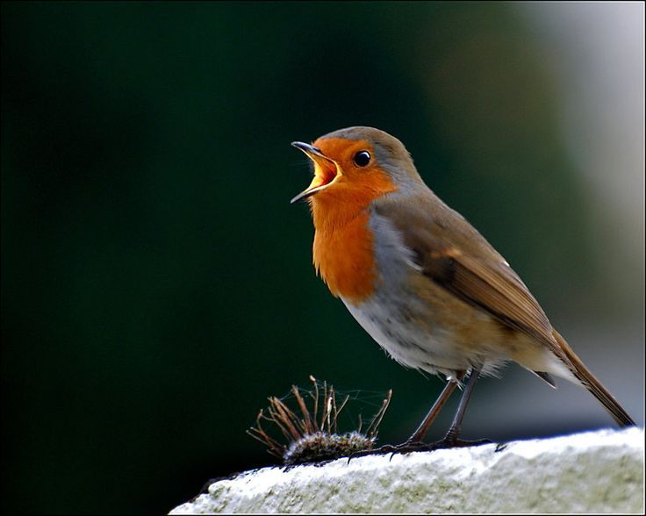
“In Commons”
“In Commons”- written while relaxing, walking around and exploring Boston Common park.
American Robin bird call=Tenor sax motif
900 × 400
Notes:
The first composition I’ll be showing is called “In Commons” which was inspired by a directed study lesson I had with the drummer Adam Cruz. After playing the Jazz standard Bye Bye Blackbird, Adam recommended we try to visualize a location and play the tune and improvise in a way that would reflect that. The first location I thought of was downtown Manhattan in the middle of rush hour and I was surprised how just visualizing this scene affected my overall playing. This inspired me to try to write a composition based on a location, so I took a trip to Boston Common to see what kind of inspiration I could get. The first thing I heard was a bird call that I later researched and discovered came from a bird called an American Robin. The rhtyhtm of the call inspired me to write a motif for the saxophone part, and this motif would be the foundation for the first section of the piece. In addition to hearing the bird call I heard a lot of outside noise from the area around the park such as brakes screeching, airplanes flying overhead every few minutes, and especially cars honking their horns, which I tried to imitate in the tenor saxophone part by having the tenors jump into harmony in the altissimo register.

Slide 4
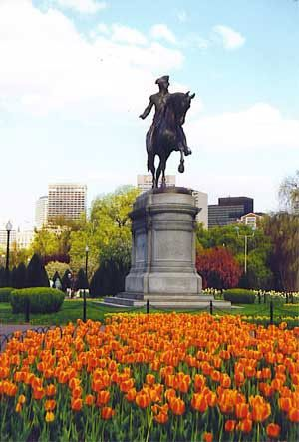
“In Commons”
First section simulates intersection of Boston Common and traffic and commotion just outside the park.
Second section represents natural beauty of the park/nature with the minimal human interference.
Free section represents serenity when everything is quiet for a moment.
Notes:
The first section of In Commons represents the intersection of Boston Common and the world just outside the park. The second and free section of the tune were inspired by the beauty and serenity of the park when it was peaceful and there wasn’t a lot of outside noise interfering.

Slide 5
“In Commons”
Malwina Masternak-Vocals
Luke Norris-Tenor Saxophone
Alex Johnson-Tenor Saxophone
Grzegorz Wlodarczyk-Bass
Jose Arturo Soto Gamboa-Piano
Jodie Michael-Drums
Notes:
Here are all of the musicians who played on In Commons and now let me play some of it.

Slide 6
“Prayer for Poway”
Written in response to shooting in my hometown of Poway, CA.
Inspired to write tune from Social Activism class.
Mixed feelings in the piece of paying tribute to those affected, but also frustration over gun violence that keeps happening (last chord very dissonant).
Notes:
The next tune I’ll be showing is a tune I wrote inspired by the Music and Social Activism class. In the class we were asked to compose a piece inspired by a social issue, and I decided to write a piece in response to a shooting in my hometown of Poway, California. The shooting took place in a synagogue, the Chabad of Poway on the last day of Passover, and I wanted the piece to be able to pay tribute to people that I knew that were affected, but also show my frustration with the recurrence of gun violence in our society. Compositionally most of the tune I used consonant harmonies but I wanted the last chord of the piece to be very dissonant to represent my anger and frustration.

Slide 7
Prayer for Poway
Malwina Masternak-Vocals
Alex Johnson-Tenor Saxophone
Grzegorz Wlodarczyk-Bass
Jose Arturo Soto Gamboa-Piano
Jodie Michael-Drums

Slide 8
Goal after graduating from BGJI: Creating my own non-profit music organization: “The Norwalk Jazz All Stars”
Mission: To expose middle school band students in Los Angeles (Norwalk/La Mirada) school districts to jazz through free private lessons with professional musicians, playing in a jazz ensemble, and having performance opportunities in the community and area.
Notes:
Aside from the musical growth I’ve felt in my playing this year, my education here at the Berklee Global Jazz Institute has helped solidify that I definitely want to be an educator in addition to being a performing musician. Without the education I’ve received here I wouldn’t have written my compositions the way I did or feel as inspired to become more socially active. This experience helped give me the idea to start the process of creating my own non profit music organization that can give music students some of the opportunities I had that I took for granted growing up. I spent time this year researching the process of creating a non profit and received a lot of help and guidance from my committee member Roya Hu, and my advisor Allan Chase. I knew I wouldn’t be able to completely create the organization while I was in school but I wanted to familiarize myself with key aspects such as writing a grant proposal and developing a clear mission statement. I learned how essential these are in developing a non profit because if you can’t really articulate what your project is, why it’s important, etc it makes it unlikely that potential funders will understand your project and want to contribute. The mission of my non profit is to expose middle school band students in Los Angeles, (Norwalk/La Mirada) school districts to jazz through free private lessons with professional musicians, playing in a jazz ensemble, and having performance opportunities in the community and area.

Slide 9
Inspiration for the project
Danilo Perez Foundation
Marco Pignataro’s Pedagogy class
Music and Social Activism Class
The Harmony Project, Mission: Growth, Community, Connection
The Jazz Angels
Notes:
There were many inspirations for me creating this non-profit and one of the main ones was seeing firsthand how the Danilo Perez Foundation is affecting social change in Panama. I had the opportunity to perform and teach for music students from the foundation when I was at the Panama Jazz Festival and could really see the impact the foundation was making on the students and community as a whole. Many of the students in the foundation come from very difficult situations and I felt the parallel back to my own experience working with the middle school students in Norwalk. An important influence for me as well was Marco’s Pedagogy class which gave me a deeper understanding on how impactful a teacher can be on a student’s development. I have a different appreciation for teachers who really develop their craft and take it seriously and want to apply this attitude in my future teaching endeavors. Another influence was also the Music and Social Activism class which encouraged me to reflect on what I wanted my career in music to look like, and how I could give back to people less fortunate than I have been through music. I also did research on some current non profit music organizations in Los Angeles such as the Harmony Project and Jazz Angels, which gave me ideas and encouragement that creating this organization was possible. The Harmony Project’s mission is comprised of 3 main facets which I’ll quote directly from their website. “Growth: To promote the healthy growth and development of children through the study, practice, and performance of music. Community: To build healthier communities by investing in the positive development of children through music. Connection: To develop children as musical ambassadors of peace, hope, and understanding amongst people of diverse cultures, background, and beliefs. I found the Connection aspect of the Harmony Project’s mission statement very similar to some of the values that The Global Jazz Institute promotes. The Jazz Angels mission, quoted from their website: “is to create an environment for young musicians to play and help preserve jazz while building self-esteem, confidence and leadership skills”. I was very motivated to discover non profits like the Harmony Project and Jazz Angels in Los Angeles, and this motivated me to keep pursuing creating my own.

Slide 10
Why this is important
Most of the students come from low income backgrounds and can’t afford private lessons.
5 of the 6 middle school music programs in Norwalk/La Mirada don’t have jazz bands or jazz combos at all, no jazz education.
Give students more opportunities to perform (not just the usual 3 or 4 concerts per school year)
Notes:
Before I came to the Berklee Global Jazz Institute, my wife was the band and orchestra teacher at a Title 1 school in Norwalk, which is a city within LA county. The vast majority of students came from low income situations and I saw how this at times had an effect on their development as musicians. None of the students could afford to take private lessons, 95% of the students were using instruments provided by the school, and 5 out of 6 middle school programs in the district had no jazz band, combos etc so kids had little to no exposure to jazz. This made me realize how fortunate I was growing up being able to have access to all of these things, and so I wanted to find a way to give these student in this area similar opportunities that I had. I also wanted to address an issue I saw with the amount of performance opportunities students have while in band for a full school year. It’s pretty often to only have maybe 3 or 4 concerts every school year, which I think doesn’t give students enough performing experience. I wanted my organization to give students more performance opportunities out in public, not just in their school gymnasium or performing arts center.

Slide 11
Vision
1st year- Create one ensemble/big band of 30 students from around Norwalk/La Mirada
Each student gets a half hour private lesson a week with professional musician
Program runs the entire school year (September-June)
Notes:
After coming up with a mission statement I wanted to create a vision for the program in it’s first year. The program will have 30 students from around the Norwalk/La Mirada school districts be apart of the organization, and have each student get a half hour private lesson a week at their school site after school. This will make it much more convenient for students to get to their lessons and will mean multiple lessons can happen at the same time in different classrooms around the school. The program will ideally run the full school year, giving the students time to progress throughout the year and allow the teachers to really track the student’s improvement.

Slide 12
Vision: Year 1
Students get at least once a month opportunities to perform gigs at venues outside of school.
Students get the opportunity to go a recording studio and record an album.
At the end of year, have a big fundraiser celebration concert to thank the donors and receive donations for the next year. Invite professional bands to perform, students sit in with the pros.
Notes:
I want the students to also be able to perform in the ensemble at least once a month outside of school, so they can gain a lot more confidence with performing. This will also give the students more of a perspective on what it feels like to be a professional musician, where most of the time we don’t have months and months to prepare the music for a performance. I also want to give students the opportunity to record an album in the studio toward the end of the year. At the end of the year, as a way to fundraise for next year, the organization will throw a big end of the year celebration concert. This will be an opportunity to recognize donors who helped contribute and also hopefully receive more donations for the next year. It’ll also be an opportunity for the students to perform as an ensemble for the last time that year, and also sit in with their private teachers and play together. This is the vision of my organization for the first year and now I’d like to play the last two compositions I recorded.

Slide 13
Artet
Inspired from a Danilo Performance Lab discussing tetrachords.
Chord progression of the song is built on roots of the notes of the tetrachord
Ab minor tetrachord (Ab Bb Cb Db), progression= Bbmi7, AbMa7, Dbmi7, Bmi7
D major tetrachord (D E F# G), progression= F#mi7, GMa7, EMa7, DMa7(#11)
Notes:
The next tune I composed is entitled Artet and was inspired by a Danilo Performance Lab in which we discussed tetrachords. Tetrachords are four note chords that we typically associate with building scales. For example, an A major scale is made up of two tetrachords, Amajor(A B C# D) and E major(E F# G# A) We discussed the potential of being able to create scales out of combining two different tetrachords together to create new sounds. I thought this was an interesting concept and wanted to try exploring it furthur by writing a chord progression based around tetra chords. The first 4 chords in the song are Bbmi7, AbMa7, Dbmi7, Bmi7 and the roots of these chords are from an Abminor tetrachord. The next 4 chords in the song are F#mi7, GMa7, EMa7, and DMa7(#11) and the roots of these chords are from a D Major tetrachord.

Slide 14
Artet
Alex Johnson-Tenor Saxophone
Grzegorz Wlodarczyk-Bass
Agnieszka Derlak-Piano
Jodie Michael-Drums

Slide 15
Like Someone in Love (Zero Gravity)
“Like Someone in Love” composed by Jimmy Van Heusen, Zero Gravity style
I wanted to explore the change in my playing with being “more comfortable with being uncomfortable”.
Notes:
The last tune I recorded was inspired by a concept that we explored throughout the entire year, which is the concept Danilo calls Zero Gravity. In the beginning of the year this concept was very uncomfortable for the most part because I was used to playing standards in a very traditional way, but this concept is about trying to get you out of your patterns and muscle memory. The Zero Gravity concept is about liberating musicians from the roles of their instruments and I tried to apply this concept to the standard “Like Someone in Love”. In the recording studio, the other musicians and I just started playing the tune without discussing who would take the melody, who would solo, how to end the tune etc.

Slide 16
Like Someone in Love (Zero Gravity)
Alex Johnson-Tenor Saxophone
Grzegorz Wlodarczyk-Bass
Agnieszka Derlak-Piano
Jodie Michael-Drums

Slide 17
Bibliography
10 Mar. 2019
<https://www.harmony-project.org/>
12 Mar. 2019
<https://jazzangels.org/>
7 Apr. 2019
<https://www.pinterest.fr/pin/431360470536088875/>
13 Apr. 2019
<https://www.pinterest.com/pin/798192733928258206/>

Slide 18
Thank You!
Danilo Perez-Artistic Director BGJI
Marco Pignataro-Managing Director BGJI
Allan Chase-Advisor
Roya Hu-Committee member
Faculty/Guest Artists
My wife and family
All the students at the BGJI
Notes:
And that concludes my presentation, thank you to everyone who made this an amazing year and I’m really grateful to have had this opportunity here at the Berklee Global Jazz Institute, Thank you.

