Slide 1
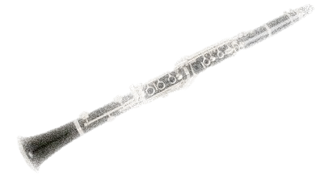
“Why not Clarinet”
Miguel Ruiz Santos
Master in Contemporary Music Performance Candidate

Slide 2
INTRODUCTION
About me
HISTORICAL CONTEXT:
The clarinet’s path along music history
The clarinet in Eastern Europe
Balkan and Klezmer Music
Jazz and Clarinetists

Slide 3
ANCIENT GREEK MUSIC
dimotikó, folk and traditional music.
Main solo instruments : clarinet and violin.
In the 19th century the klarino music was very popular, which was "exported" by the gypsies to the rest of Europe.
From Greece to Eastern Europe:
Ancient Greek music was the base for Persian music.
It was also an influence in Byzantine music, Arabic music and Balkan music.
BALKAN and KLEZMER MUSIC.
The clarinet players and clarinet´s role in Gypsy music and Klezmer.

Slide 4
BALKAN AND KLEZMER
CLARINETISTS

Slide 5
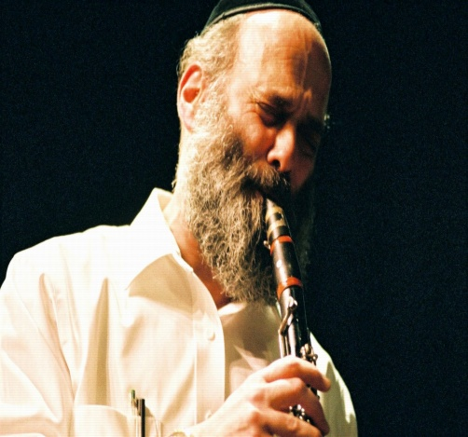
Vasilis Saleas
Giora Feidman
Greece
Argentina/Israel
Hüsnü Senlendirici
Turkey
Andy Statman
USA

Slide 6
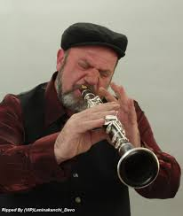
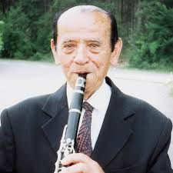
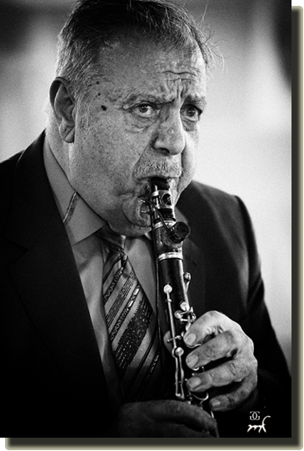
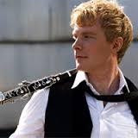
Tale Ognenovski
Ivo Papazov
Macedonia
Bulgaria
Petroloukas Chalkias
Martin Frost
Greece
Sweden

Slide 7
JAZZ
AND
CLARINETISTS

Slide 8
Chapters:
1- At the beginning:
New Orleans clarinetists
2- The Glorious Swing Era for clarinet
3- The Bebop:
The clarinet in danger of extinction

Slide 9
1- AT THE BEGINNING:
NEW ORLEANS CLARINETISTS
At the beginning of jazz music, the clarinet was very common.
There were a large number of clarinetists who played Dixieland, Swing and Classic Jazz.
Heritage of Jewish musicians-Klezmorim

Slide 10
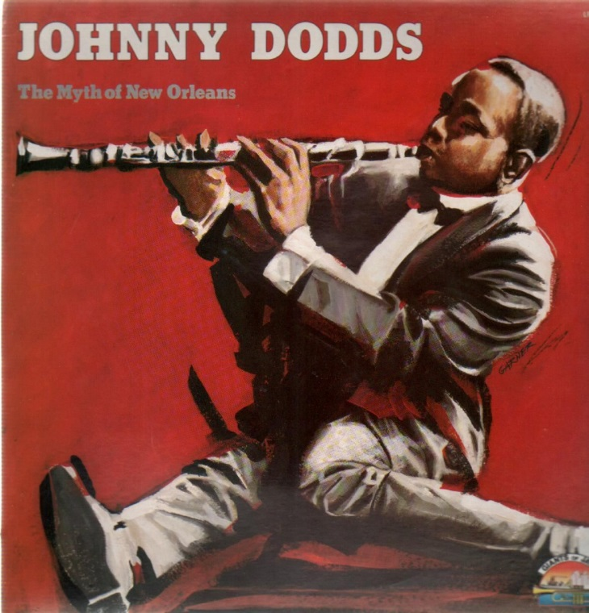
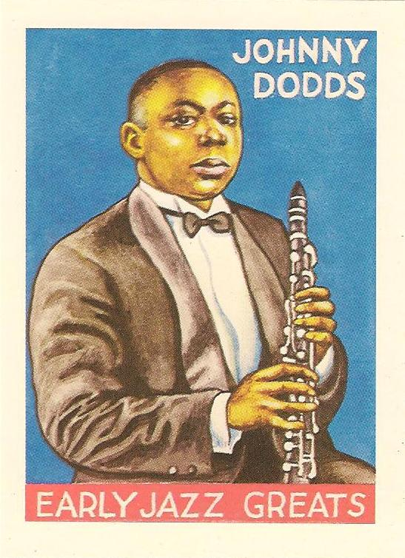
1892-Born in New Orleans the great clarinetist Johnny Dodds Jazz, was one of the most famous clarinetists of his time. Some years later, he joined the famous group of Louis Armstrong's "Hot Five"

Slide 11
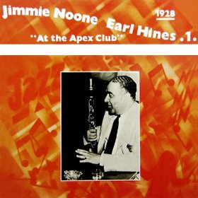
Jimmie Noone led his own band in the “Apex Club" in Chicago. He broke with the traditional format of jazz bands and created a new style, a type of chamber jazz, where the melody was clear and audible.

Slide 12
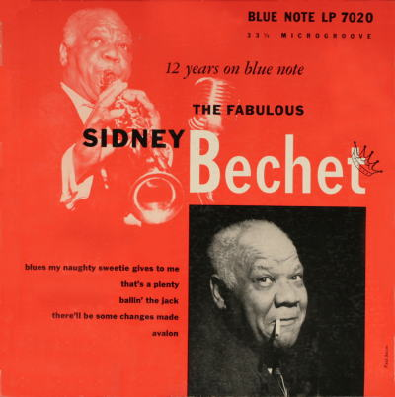
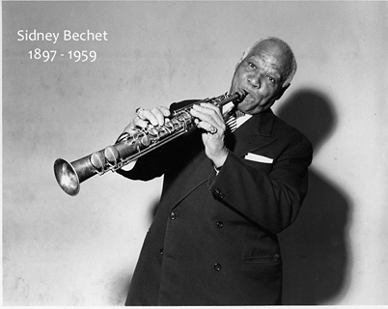

Slide 13
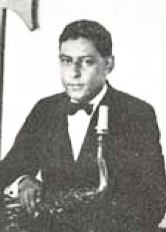
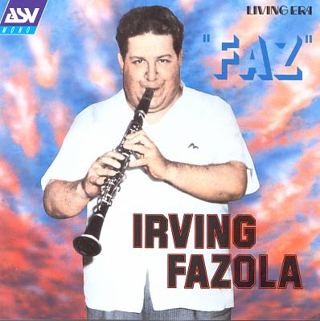
Lorenzo Tio

Slide 14
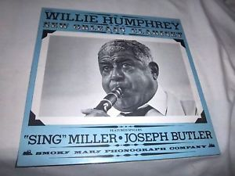

Slide 15
2- The Glorious Swing Era for clarinet
About 1935 the beginning of the Age of Swing is officially regarded: the golden age of big bands and the clarinet.
Benny Goodman in 1937 was named the "King of Swing".
Buster Bailey, Barney Bigard, Irving Fazola (in his second stage), Artie Shaw and many other clarinet players should be highlighted in this style.

Slide 16
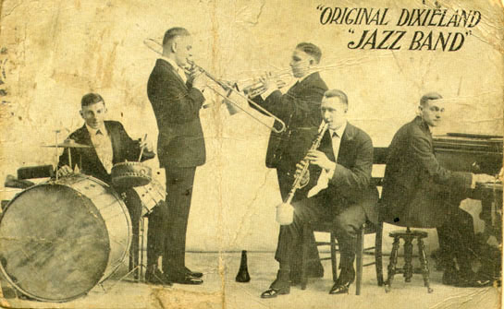
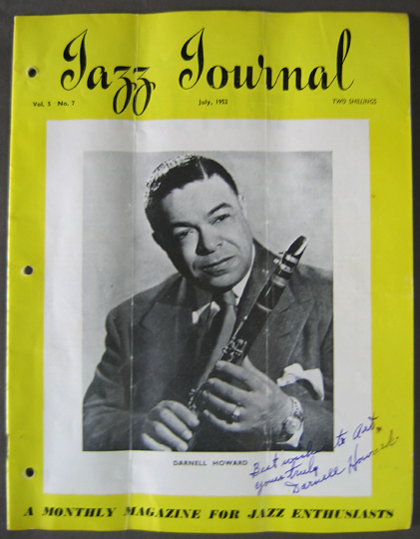
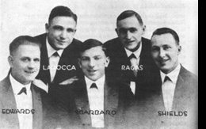
Darnell Howard-1953

Slide 17
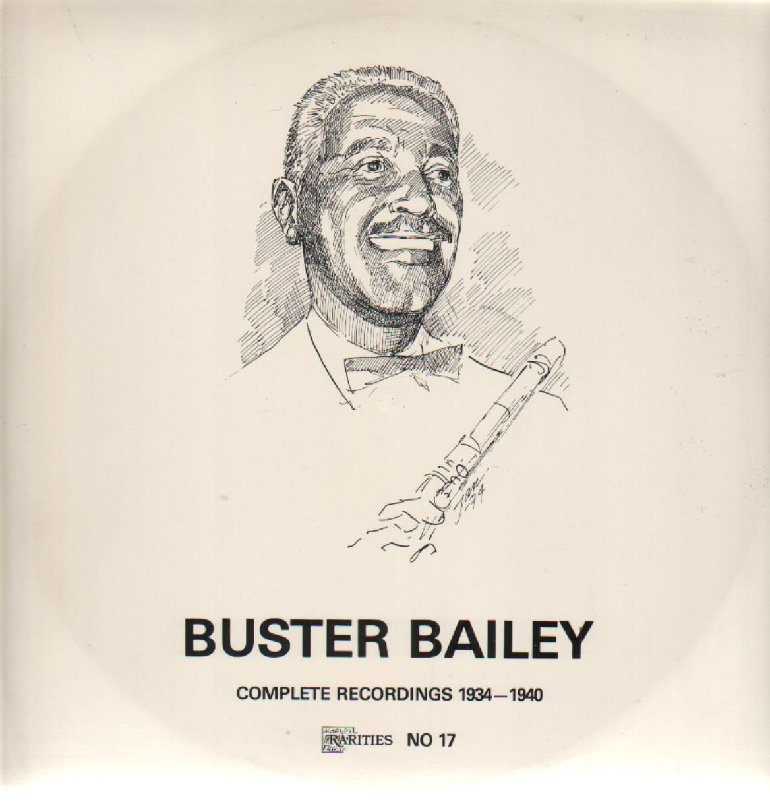
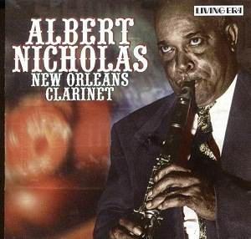

Slide 18
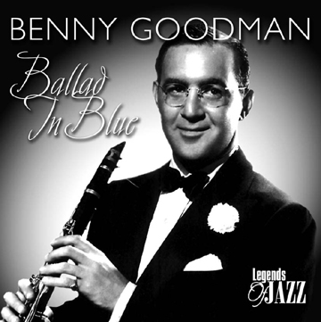
THE KING OF SWING
(USA-Poland)

Slide 19
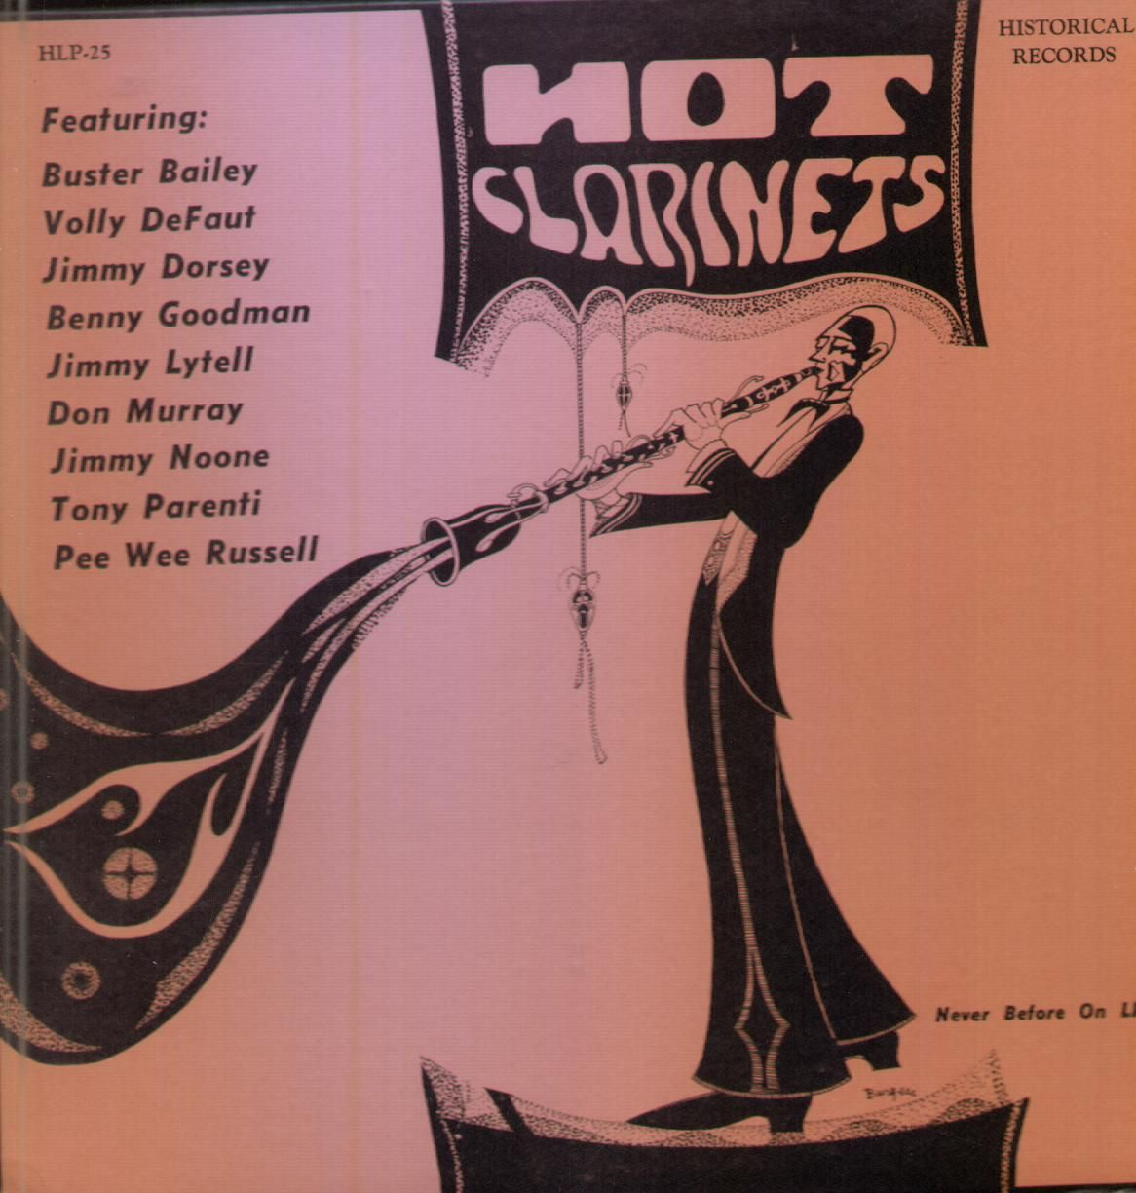
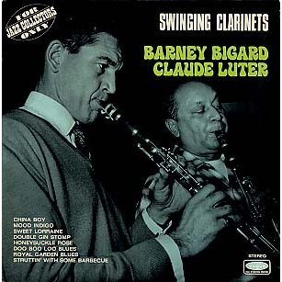
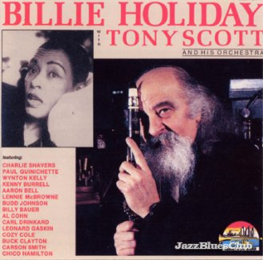

Slide 20
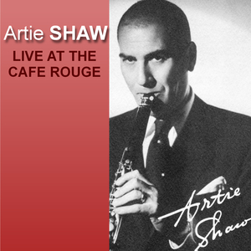
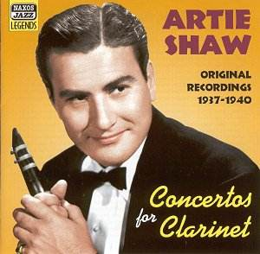
USA-(Russia/Austria)

Slide 21
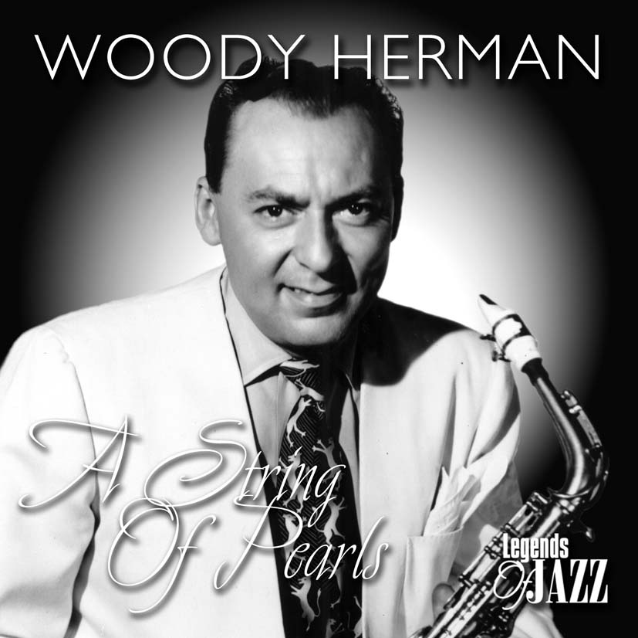
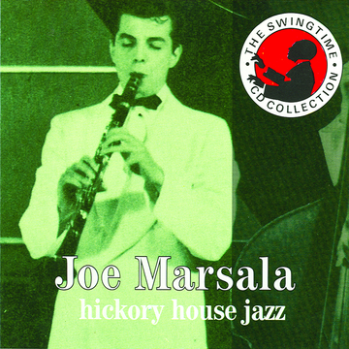
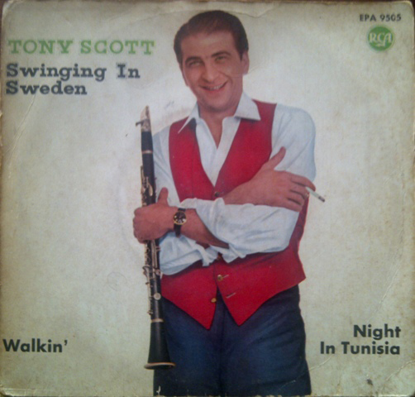

Slide 22
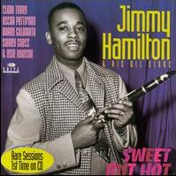
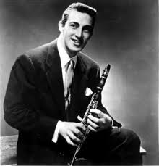
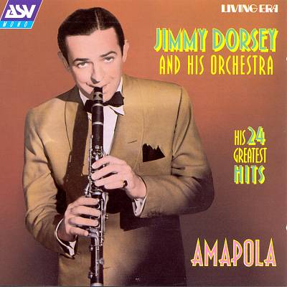
Eddie Miller

Slide 23
3- The Bebop:
The clarinet in danger of extinction
1939-1940. With the Great Depression and the approach of 2nd World War, big bands changed into combos with fewer members (cheaper)
The clarinet and trombone were gradually disappearing from the jazz stage.
Buddy DeFranco is one of the great clarinetists of all time and was the most famous clarinet player in the 40s. He was able to adapt to the more modern jazz and bebop.

Slide 24
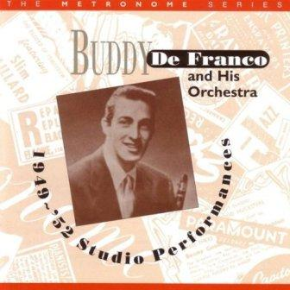
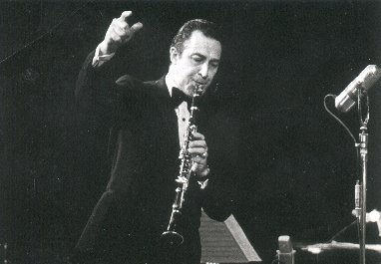
BUDDY De FRANCO

Slide 25
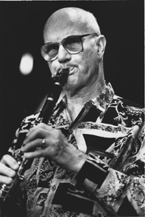
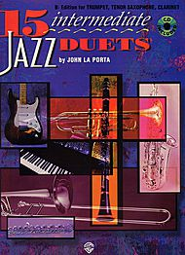
More….and more
John Laporta

Slide 26
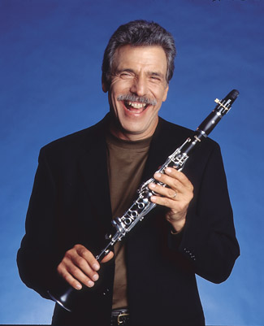

Slide 27
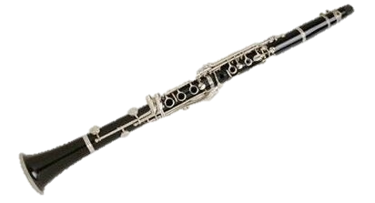
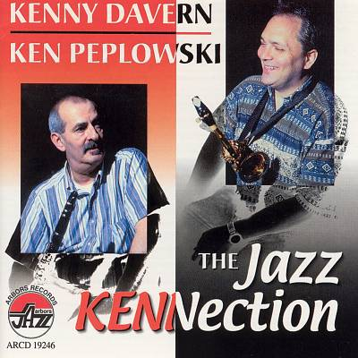
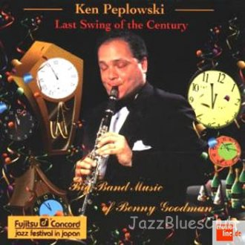

Slide 28
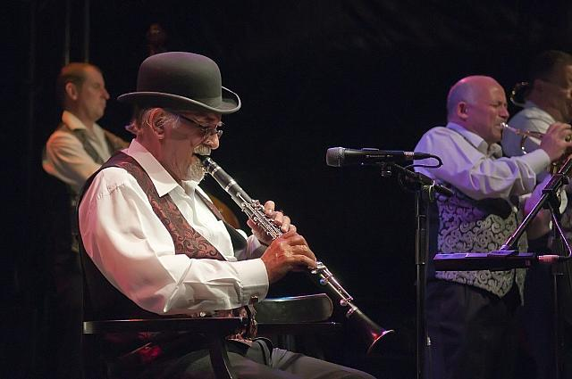
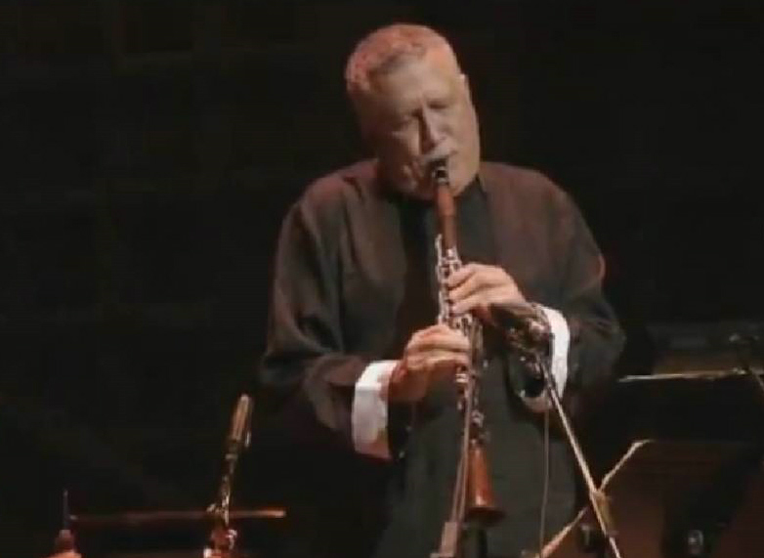
Acker Bilk
Paquito D’Rivera

Slide 29
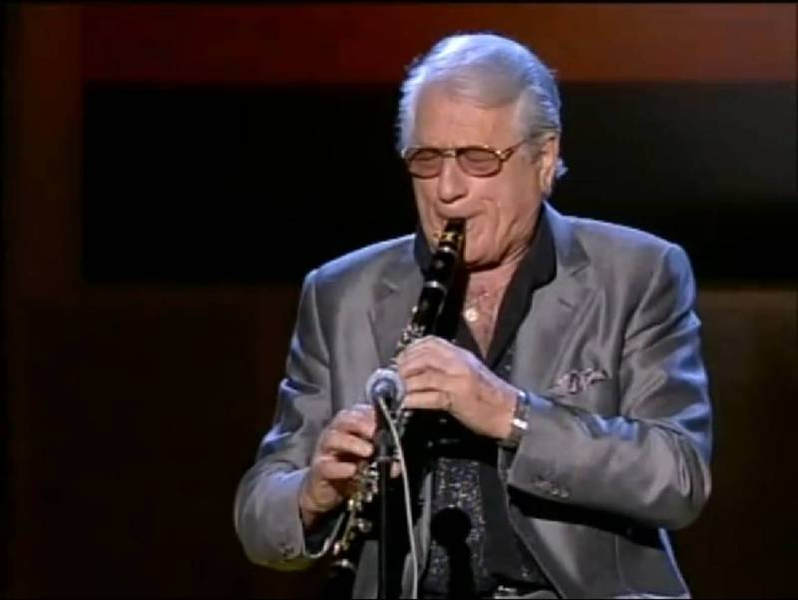
PEDRO ITURRALDE

Slide 30
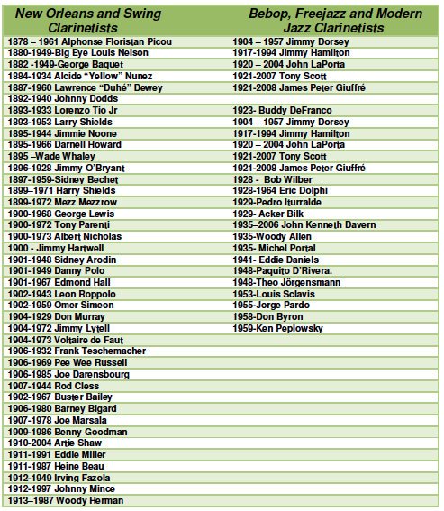
50vs21

Slide 31
WHY AM I DOING THIS WORK?
WHAT DO I WANT TO ACHIEVE WITH THIS?

Slide 32
MAIN GOAL:
Diffusion of clarinet in the current music scene to increase its use, especially in jazz and modern music .
Objectives:
• The study and interpretation of various musical styles.
• The composition and adaptation of a new repertoire for the clarinet.
• The search for an artistic voice and identity.
• The recording of the new repertoire.
• Claiming the clarinet as versatile and dynamic instrument.

Slide 33
Composition of modern music pieces using the clarinet as the main instrument
-To provide greater clarinet repertoire in these styles
-To be able to express myself as an artist and find my own style
Recording my works and collaborations with my friends
-Share my music with the audience
-Extend my personal repertoire and the general clarinet repertoire
Creating a website
- A platform for the clarinet diffusion
- Self Promotion and sharing my music

Slide 34
Composition of Modern Music:
My Music
My Recordings

Slide 35
PIECE Nº 1
TITTLE | PUTTING ON THE RITZ FOR CLARINETS
COMPOSED IN | September 2013
INFLUENCES | Dixieland, Classic Jazz
RECORDING DATE | October 3rd, 2013
MUSICIANS | Miguel Ruiz Santos, Bb Clarinet-arranger Beth Michelle Schofield, Eb Sopran Clarinet Nick Zeigler, Bass Clarinet
ENGINEER | Kyle Pyke
LINK AUDIO | www.clarinetjazz.es/miguelruizsantos/media
FEATURES | -The goal in this piece was to give prominence to the clarinet in a jazz context. -This is an arrangement of a known jazz standard only for clarinets, for a Clarinet group. -My first idea was to do it for a clarinet quartet, but there were not clarinet players enough at school, and I tried to reduce it for a trio. -The original form of topic is maintained, but at the end there is an original coda. (No SOLOS section) -Instrumentation: Eb Sopran Clarinet-Bb clarinet-Bass Clarinet

Slide 36
PIECE Nº 1
TITTLE | PUTTING ON THE RITZ FOR COMBO
COMPOSED IN | September-October 2013
INFLUENCES | Dixieland, Classic Jazz
RECORDING DATE | October 29th, 2013
MUSICIANS | Miguel Ruiz Santos, Bb Clarinet-arranger Alexey León, Alto Sax Max Ridley, Doublebass Rodrigo Malvido, Drums
ENGINEER | Kyle Pyke
LINK AUDIO | www.clarinetjazz.es/miguelruizsantos/media
FEATURES | -This is a version for a jazz combo with the clarinet as a leader. -With this kind of , I can try how clarinet works in different settings, with other instruments. -The form of the tune is this arrangement is longer, with SOLOS section: Intro-A-A-B-A-SOLOS-B-A-C-A´ -Instrumentation: Acoustic- Bb clarinet, Alto Sax, Doublebass and Drums.

Slide 37
PIECE Nº 3
TITTLE | PATA TIESA
COMPOSED IN | November 2013- March 2014
INFLUENCES | Latin Jazz- Brazilian music.
RECORDING DATE | March 20th and overdubs
MUSICIANS | Miguel Ruiz Santos, Clarinet-composer Peter Connolly, ac Guitar Haojun Qi, Bass Avila Santo, Percussion
ENGINEER | Miguel Ruiz Santos
LINK AUDIO | ---
FEATURES | -This work came about from an improvisation because of my study of Latin music. -The goal was to make a typical composition of Latin music to absorb its elements and then, to be able to do a Jazz fusion tune with other styles. -It's a classic bossa nova, but played by Clarinet, not very common instrument in that style. --Instrumentation: Bb clarinet, Ac. Guitar, Bass and Percussion

Slide 38
PIECE Nº 4
TITTLE | LOVE IN MARCH
COMPOSED IN | November-December 2013
INFLUENCES | Jazz Ballad and Classical Music.
RECORDING DATE | February 10th, 2014
MUSICIANS | Miguel Ruiz Santos, Clarinet-composer Fernando Pascual, violin Pau Ruiz, violin Xavi Puig, viola Elena Ruano, cello
ENGINEER | Piereluigi Barberis & Kyle Pyke
LINK AUDIO | www.clarinetjazz.es/miguelruizsantos/media
FEATURES | Starting from one of the most used formations and instrumentations in classical music, in this work I tried compose something different. -I used the string quartet with clarinet, following the footsteps of Mozart and Brahms. “Love in March” is a jazz ballad that is special because I create a game with classical and jazz style passages during most of the piece. -Form: Intro-A-B-A-SOLOS-A´-CODA

Slide 39
PIECE Nº 5
TITTLE | FLAMINCOU!
COMPOSED IN | December 2013-January 2014
INFLUENCES | Flamenco music, Spanish Folk music ( Seguidillas Manchegas) and Latin Music
RECORDING DATE | March 12th, 2014
MUSICIANS | Miguel Ruiz Santos,Clarinet-composer Piotr Orzechowsky,Piano Peter Connolly, ac. Guitar Daniel Toledo,Bass Sergio Martínez,Percussion
ENGINEER | Corey Ashe-Bradford & Kyle Spyke
LINK AUDIO | www.clarinetjazz.es/miguelruizsantos/media
FEATURES | Music based bulerías and mixed with Latin rhythms. -Form: Intro+A+B+A+C+A+SOLOS+C+A+CODA -Introduction where the instruments are presented -“Topic A” that is the link to all the different topics which join flamenco harmony to the bulerias rhythm. -“Topic B” with Latin rhythms -“Topic C” with Seguidillas Manchegas, typical rhythm of Spanish folk music. In Flamincou!, I tried you combine two of my passions, Spanish and Latin music.

Slide 40
PIECE Nº 6
TITTLE | DOS ASTILLAS
COMPOSED IN | January 2014
INFLUENCES | Rumba Flamenca and Latin Rhythms
RECORDING DATE | March 12th, 2014
MUSICIANS | Miguel Ruiz Santos,Clarinet-composer Piotr Orzechowsky,Piano Peter Connolly, ac. Guitar Daniel Toledo,Bass Sergio Martínez,Percussion
ENGINEER | Corey Ashe-Bradford & Kyle Pyke
LINK AUDIO | www.clarinetjazz.es/miguelruizsantos/media
FEATURES | -Inspired by"Barri laComa" (Perico Sambeat). -The idea is mixing the typical “Rythm and Changes” with the rhythm of rumba flamenca. -In addition to this, following my previous line of work, I wanted to join the two types of rumba, Cuban and Flamenca, making a work of Fusion Jazz.

Slide 41
PIECE Nº 7
TITTLE | AKANÓNISTO
COMPOSED IN | April-May 2014
INFLUENCES | Greek, Turkish Music
RECORDING DATE | May 30th , 2014
MUSICIANS | Miguel Ruiz Santos, Clarinet-composer Djudju Hartono, Piano Peter Connolly, ac Guitar Haojun Qi, Bass Alex Williams, Drums Mt Aditya Srinivasan, Tabla and Percussion.
ENGINEER | Tim Shull & Kyle Pyke
LINK AUDIO | www.clarinetjazz.es/miguelruizsantos/media
FEATURES | Original composition also based on the Greek modes and where traditional Greek and Turkish rhythms are mixed with jazz Style. The rhythmic signature is in 5/8 and 6/8 and I tried to use the rhythmic modulation. This is a new concept for me. - Great contrast between rhythm and the different topics. Form: INTRO (Guitar Solo)- A-B B- A- SOLOS- B-A Similar to a Rondo (Classical Music inflence) Acoustic instrumentation.

Slide 42
PIECE Nº 8
TITTLE | KARSÍ- LLAMAS
COMPOSED IN | February-March 2014
INFLUENCES | East-European Music
RECORDING DATE | April 11th, 2014
MUSICIANS | Miguel Ruiz Santos, Clarinet-composer Djudju Hartono, Piano Juan Cristóbal Aliaga, el. Guitar Andrea Fraenzel, Bass Mikael Cahubert, Drums Ilias Papantoniou, Darbuka
ENGINEER | Tim Shull & Kyle Pyke
LINK AUDIO | www.clarinetjazz.es/miguelruizsantos/media
FEATURES | Original composition based on the Greek modes, where popular styles of Eastern Europe and jazz are mixed. - It includes many rhythmic changes because I looked to create the atmosphere of dances. - Great contrast between rhythm and the different topics. - Form: INTRO-A-B-B'-Solos-A Electro-acoustic instrumentation.

Slide 43
Clarinetjazz.es wants to be a platform and a meeting point for clarinetists, but not only that, it's a website for dissemination and sharing material, dedicated to all music lovers in general and clarinet lovers and musicians in particular.

Slide 44
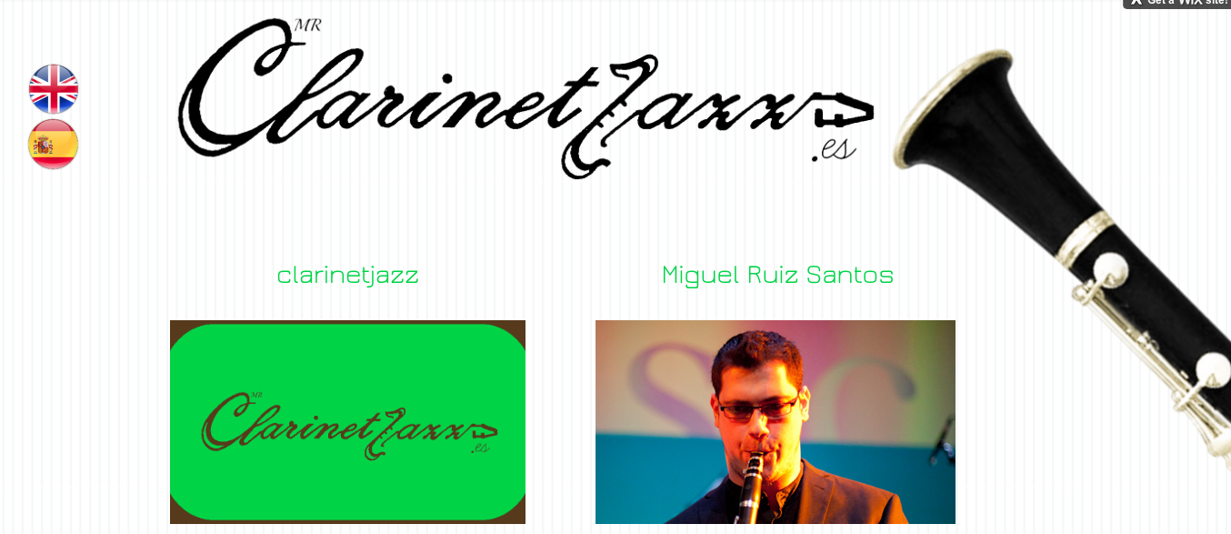
Structure of the web
HOME PAGE

Slide 45
CLARINETJAZZ.ES/MENU
Miguel Ruiz Santos/HOME PAGE-MENU

Slide 46
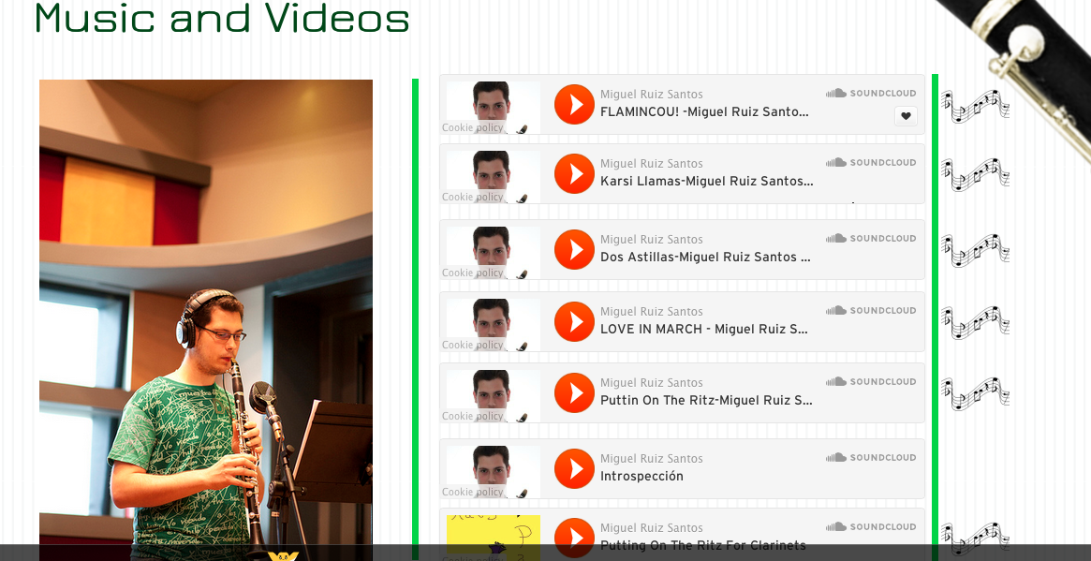
MY MUSIC
THE MEDIA FILES
FREE USE
MY COMPOSITIONS
THE SCORES

Slide 47
CONTACT
Put all modern clarinetists in contact with each other
Publicize projects similar to mine
Publicize young and upcoming clarinetists
www.clarinetjazz.es

Slide 48
CONCLUSIONS:
-The clarinet is a very dynamic
and versatile instrument
-It can be used in many different styles
-It has to recover its lost relevance
and its role in modern music
-THERE´S POWER IN NUMBERS!
Working together, we are stronger…

Slide 49
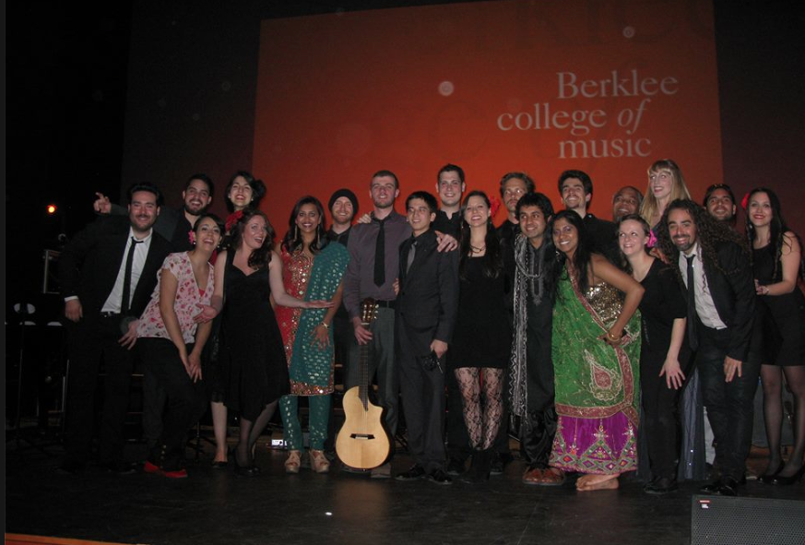
¡Gracias por venir!
-Teachers
-Faculty Members
-Staff
-Classmates
-FRIENDS!
Thank you for coming!

Slide 50
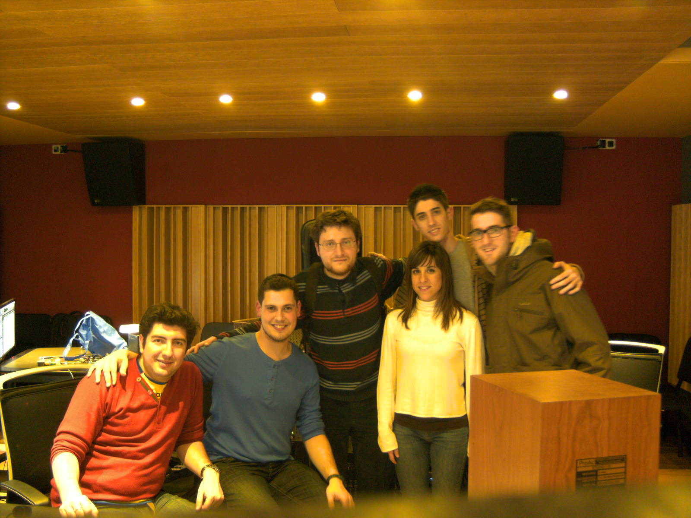
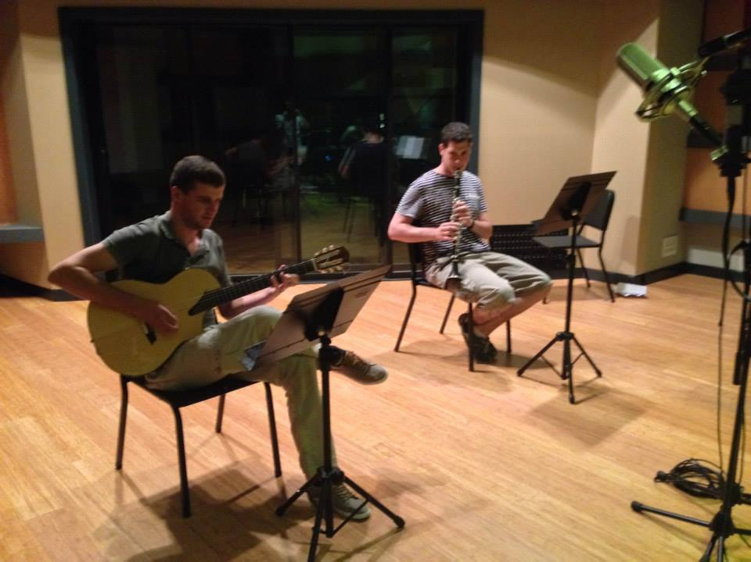
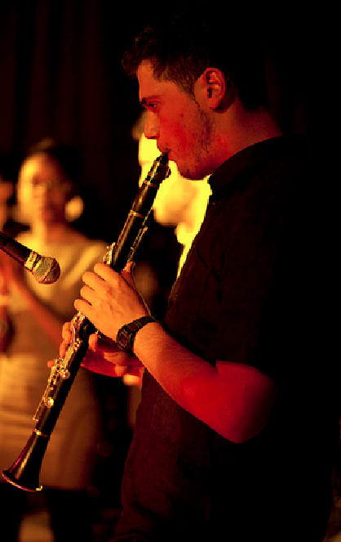
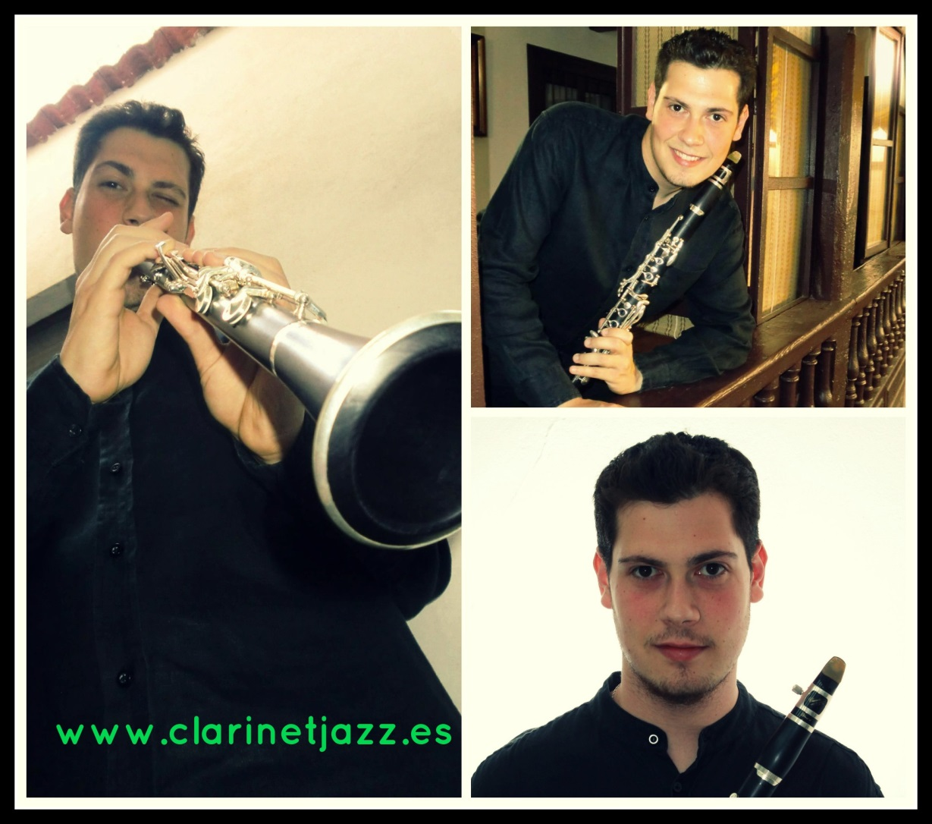
Miguel Ruiz Santos
Master in Contemporary
Music Performance.
Berklee Valencia.
2014

