Slide 1
From singer to songwriter: the path of an artist in Brazilian music
Luiza Sales Rangel
Culminating Experience Project
Masters in Contemporary Performance
Berklee Valencia, 2014

Slide 2
The project

Slide 3
Introduction: artistic background
Project Objective
Starting as singer, go through the process of becoming a composer and a better musician in different aspects.
Motivations
Development of a deeper relation with music making
Broadening of musical knowledge
Need to explore composition as a new form of musical expression
Go from reproducing other’s music to creating my own music
Justification
Growing number of female singer-songwriters in Brazilian music
Need to differentiate my work from the others

Slide 4
Context

Slide 5
The gender gap in music
Why are there more male composers than female?
Female singer and composers in Brazil
Time line:
Chiquinha Gonzaga (end of XIX century)
D. Ivone Lara (first half of XX century)
Joyce, Rosa Passos, Tânia Maria, Sueli Costa (starting on 1970’s)
Marisa Monte, Adriana Calcanhoto, Zélia Duncan, Ana Carolina (starting on 1990’s)
Karina Bur, Antonia Adnet, Céu, Tulipa Ruiz, NUA, Maria Gadú, Ana Clara Horta, Bruna Caram, etc.(XXI century)

Slide 6
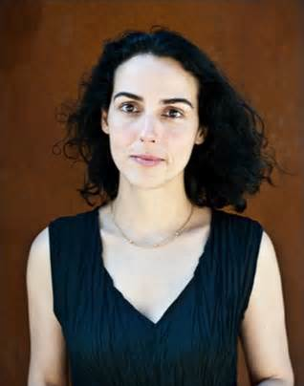
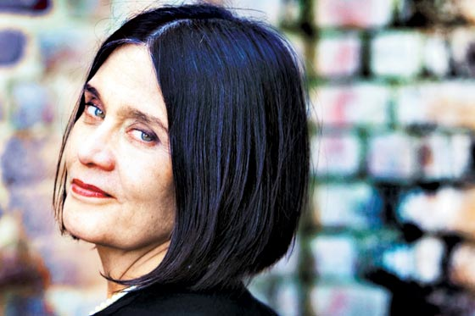
Interviews
Clarice Assad
Joyce Moreno

Slide 7
Process
Composition and recording of six original songs, based on Brazilian music styles, as a pre-production process for my second album.
Each song will be analyzed, showing the most important aspects of musical composition and main learning outcomes from each recording and composition experience.
The songs are organized in chronological order, according to the recording dates.

Slide 8
Compositions

Slide 9
“Mansinho” (Luiza Sales & Gustavo Pereira)
Style: bossa – nova
Musical form: doesn’t have clear sections
Creation of a “bridge” to add variation and build up to a culminating point in the “emotional timeline” of the arrangement
The “hook” of the song:

Slide 11
“Chuva” (Luiza Sales)
Style: baião
Recording experience with Chico Pinheiro
Influenced by Hermeto Pascoal, specially themes like “Forró em Santo André” and “Forró Brasil”
Harmony: modal interchange and chords moving by thirds – “Coltrane Changes”
Interlude section – use of “scat” as differentiation resource – the voice as an instrument

Slide 12
“Chuva”
Use of re-harmonization as a tool to add variation.
Original Harmony:
Re-harmonization:

Slide 14
“A Frio” (Luiza Sales & Pedro Carneiro)
Style: slow bossa-nova / ballad
Collaborative compositional process
New strategy to approach music composition
Chord progression resambles Tom Jobim’s “Águas de Março”- chord inversions and bass line structured in a descendent movement

Slide 15
“A Frio”
Introduction melody originally written for another song
First time recording voice and guitar simultaneously – technical and artistic challenge
Use of clarinet and vibraphone to add a sophisticated timbre to the arrangement
Use of introduction, solo section, backgrounds in the arrangement

Slide 16
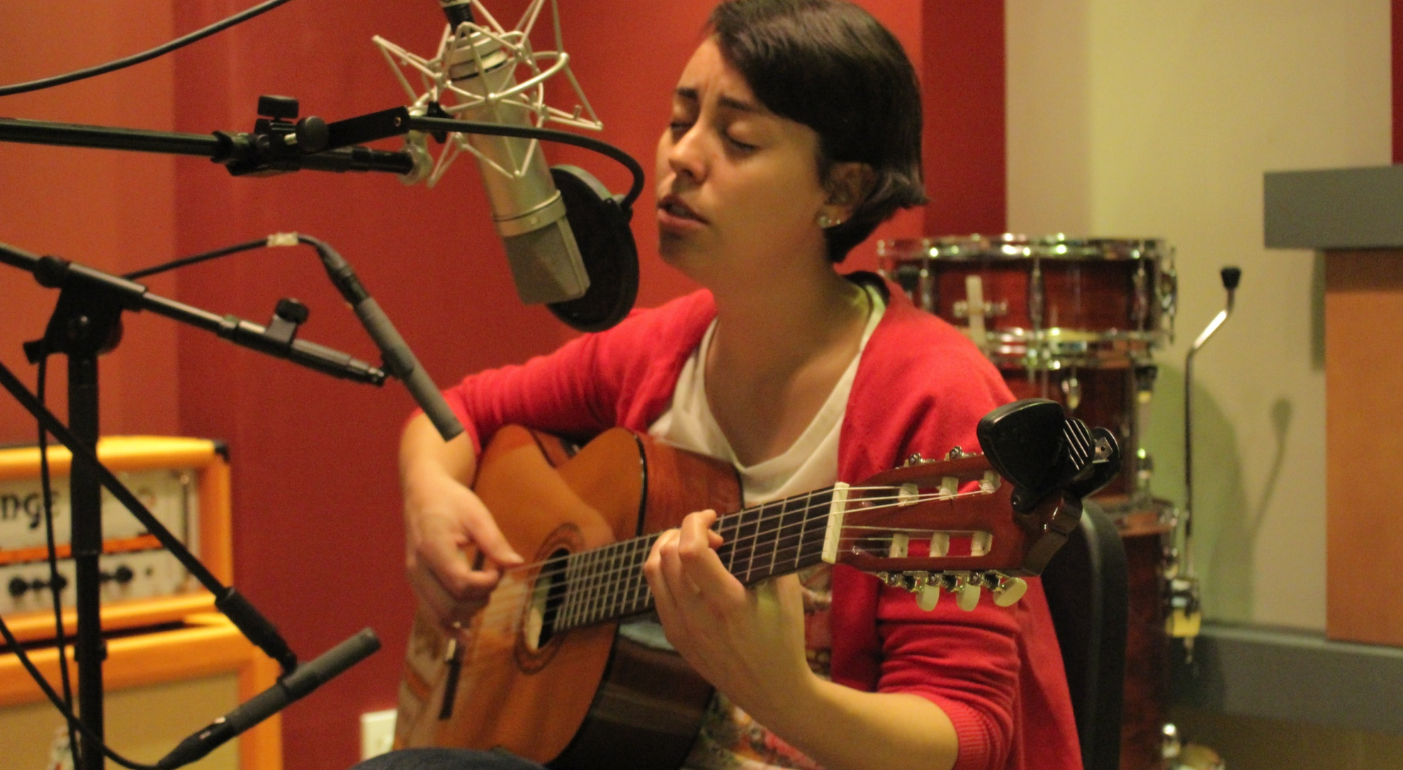

Slide 17
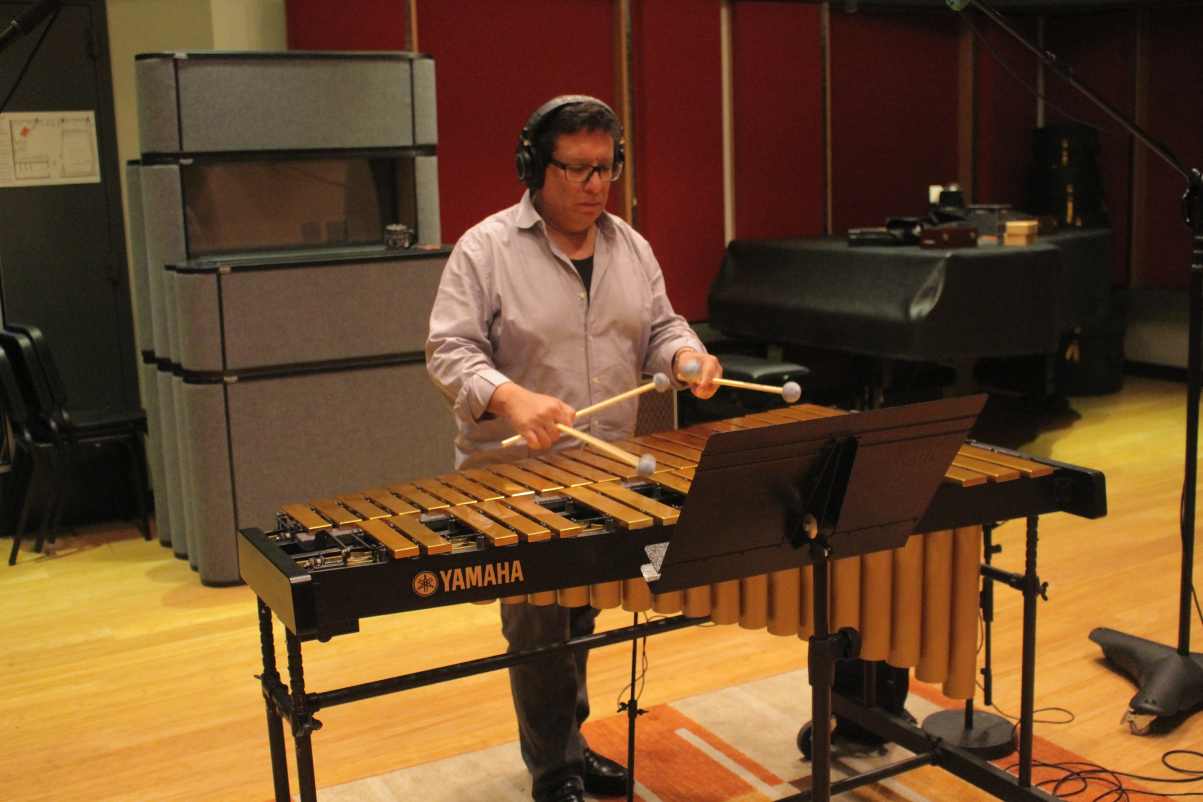

Slide 18
“Aventureira” (Luiza Sales & Gustavo Pereira)
Style: cha-cha / latin
Inspired by João Donato, in themes such as “Amazonas” and “Nasci Para Bailar”
Inspired by the Latin Jazz Ensemble experience
Vocabulary resources: piano montuno, clave, percussion instruments, “Tito Puente’s hits”
Vocal improvisation section – result of a research in Private Instruction and Topics in Improvisation.
Transcriptions of Brazilian singer Leny Andrade – use of improvisation as a resource to differentiate from other singers and to fuse Brazilian music with jazz.

Slide 20
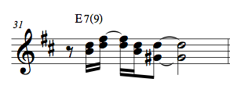
“Força do Tempo” (Luiza Sales & Vinicius Castro)
Style: maracatu
Collaboration with the Batucada Ensemble at Berklee Valencia
Modalism in Brazilian music
Use of new guitar resources for the arrangement – harmonics and rhythmic exploration
Melody structured over repeated notes, very rhythmic
Contrasting interlude “reveals” Dorian mode

Slide 22
“Janelas Floridas” (Luiza Sales)
Style: Choro-canção
Inspired by the research made on Choro, in the Private Instruction
The use of Choro as a tool to develop vocal technique for singers
Composed closer to the contemporary Choro, with the use of modal interchange chords
Use of instruments foreign to the original instrumentation of the “Regional de Choro”
More complex motivic development in the melody and rhythm
Doesn’t follow the original Choro form ABACA (inherited by the Rondó form, of classical music)

Slide 23
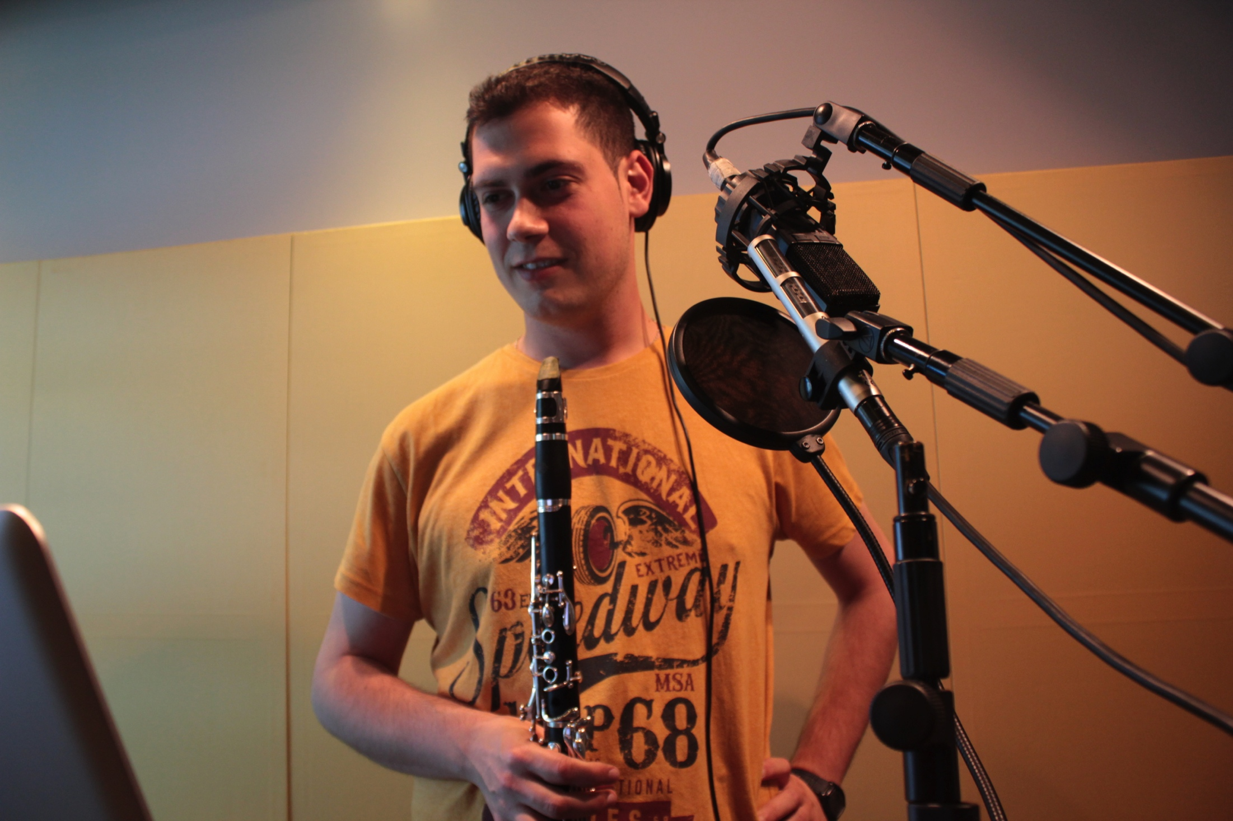

Slide 24
Conclusions

Slide 25
What is necessary to become a singer-songwriter?
What are the “must-have” skills?
What skills were developed during the year?
MUSICAL SKILLS
Playing a harmonic instrument
Harmony knowledge
Ear training
Improvisation
Vocal performance

Slide 27
TECHNOLOGICAL SKILLS
Basic video editing
Basic use of Internet tools
Basic Music Business knowledge
Music Production Knowledge
Basic knowledge of Protools and Finale
PERSONAL SKILLS
Being a band leader
Networking

Slide 28
Final product
Six original compositions
Youtube channel with five new videos

Slide 29
Thank you!

